Slide 1




BRAINWAVE CODERS
Intelligent LLM Security Firewall
Real-world protection for AI chatbots, company documents, customer data, and high-risk answers
SAHIL KUMAR PATTNAIK
V.KEERTAN
SUSANTA KUMAR PADHI
ANIMESH MANDAL
HACKATOPIA 2K26

Slide 2










PROBLEM STATEMENT
DIRECT PROMPT
INJECTION
A user tries to override rules or extract protected information
INDIRECT PROMPT INJECTION
AI assistants are being used with real customer and company data
A vendor PDF or webpage contains hidden instructions
A support bot may reveal another customer’s details
SYSTEM-PROMPT
EXTRACTION
MULTIPLE THREATS.
A prompt asks the model to reveal private system rules
A hidden instruction in a PDF can hijack an AI summary
SENSITIVE DATA
LEAKAGE
REAL RISKS.
REAL IMPACT.
An employee may be tricked into exposing internal prompts
Customer records, credentials, or personal data exposed
Private IDs, emails, or account details may appear in replies
MALICIOUS OR UNSAFE
OUTPUT GENERATION
An AI assistant may give unsafe or unverified guidance
Responses may need filtering or human review before delivery
Basic keyword filters can miss hidden or rewritten attacks
LIMITATIONS OF
SINGLE-GUARDRAIL DEFENSES
Use multiple checks: input, context, policy, and output

Slide 3


















THREAT LANDSCAPE
Everyday AI use can turn untrusted content into business risk
INPUT SOURCES
ATTACK VECTORS
POTENTIAL IMPACT
Customer chat
Hidden instructions
Customer privacy breach
Vendor email
Private-data requests
Leaked company documents
Shared PDF / webpage
Unsafe or false answers
Bad decisions / lost trust
Internal apps

Slide 4

















SENTINEL AI
GATEWAY SOLUTION
Screens each request and response before it reaches users—without replacing the LLM itself.
SENTINEL AI GATEWAY
INPUT NORMALIZATION
Cleans and standardizes incoming content
TRUSTED
LLM ENDPOINT
USERS & APPS
External
Input
Sanitized
Request
Web
Mobile
APIs
Enterprise
Systems
RISK ANALYSIS
Input
Detect threats and assigns risk levels
POLICY ENGINE
Applies rules and enforces security policies
Safe
Response
Model
Response
OUTPUT VALIDATION
Large Language Model Services
Verifies and sanitizes
model responses

Slide 5




















END-TO-END
WORKFLOW
A practical flow for protecting everyday AI workflows from hidden instructions and data exposure.
ALLOW
PROMPT/ CONTEXT
RISK ANALYSIS
USER
INPUT
INPUT NORMALIZATION
POLICY
DECISION
SANITIZE
LLM PROCESSING
OUTPUT INSPECTION
BLOCK
SAFE
RESPONSE

Slide 6














MULTI-LAYER
INPUT SCANNING
DEFENSE
INJECTION DETECTION
ARCHITECTURE
SENSITIVE DATA DETECTION
Independent checks inspect inputs, detect sensitive data, enforce policy, review outputs, and record evidence.
POLICY AND RISK ENGINE
OUTPUT VALIDATION
AUDIT AND EVIDENCE LOGGING

Slide 7











RISK SCORING AND DECISION FLOWCHART
Risk-based action: allow normal requests, sanitize suspicious content, or block and escalate high-risk cases.
RISK SCORING
Evaluate prompt
and context
ASSESS
RISK LEVEL
LOW
MEDIUM
LOW RISK
MEDIUM RISK
HIGH RISK
PASS THROUGH
SANITIZE OR CONSTRAIN
BLOCK OR ESCALATE
Allow routine, low-risk requests to continue
Remove or neutralize suspicious content before forwarding
Stop risky requests or send them for human review

Slide 8
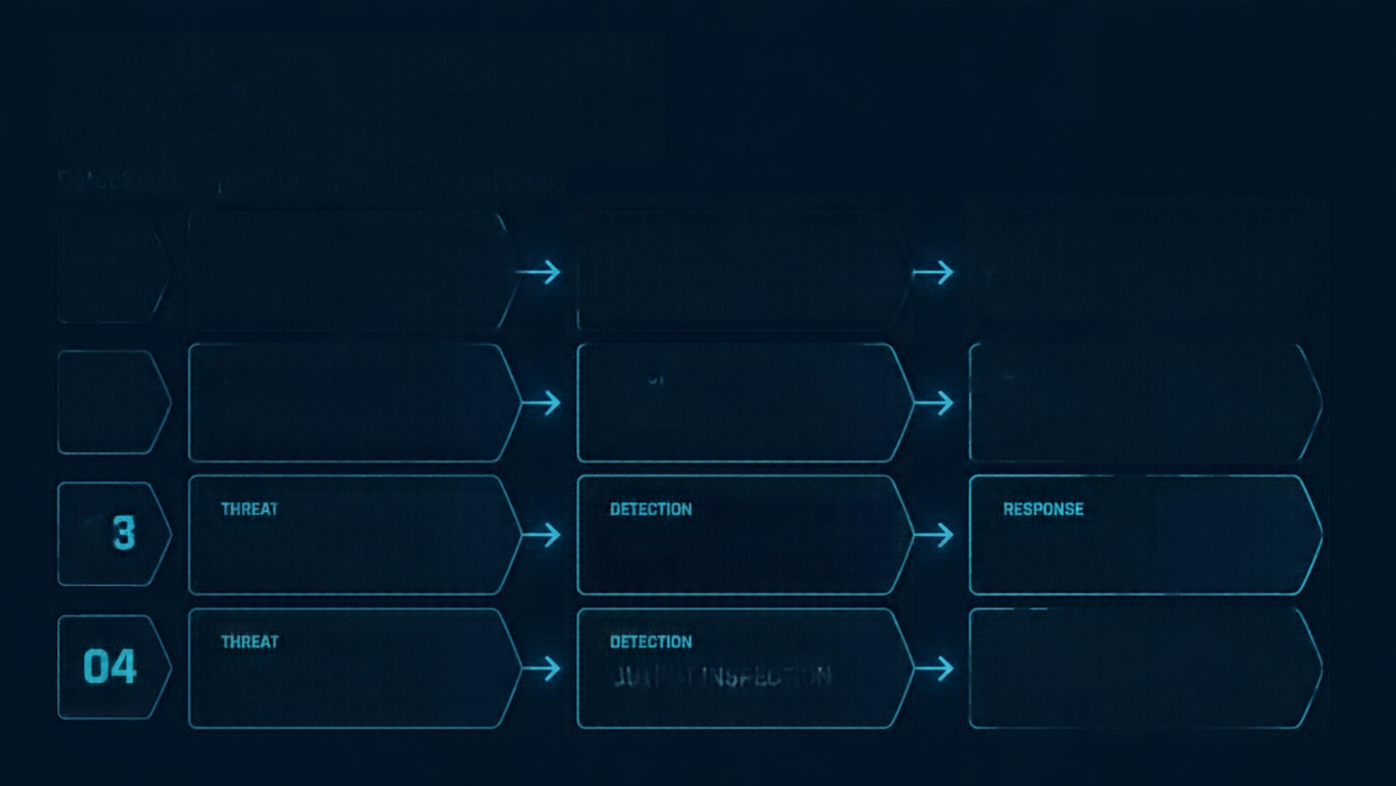
























EXAMPLE SCENARIOS / USE CASES
Four realistic examples of how SENTINEL AI can reduce common LLM risks
01
THREAT
DETECTION
RESPONSE
Hidden instruction in vendor PDF
PROMPT INJECTION FLAGGED
UNSAFE INSTRUCTION BLOCKED
02
THREAT
DETECTION
RESPONSE
Customer asks for another user’s account data
PERSONAL DATA REQUEST DETECTED
DATA WITHHELD
03
THREAT
DETECTION
RESPONSE
Employee asks for hidden system instructions
EXTRACTION ATTEMPT FLAGGED
BLOCKED / REVIEWED
04
THREAT
DETECTION
RESPONSE
High-risk health question
SAFER REPLY + EXPERT REFERRAL
OUTPUT CHECKED FOR SAFETY

Slide 9












IMPLEMENTATION
AND IMPACT
PRACTICAL VALUE IN REAL WORKFLOWS
APPLICATION/
API GATEWAY
POLICY
ENGINE
THREAT
DETECTORS
Reduces exposure of sensitive data
Flags prompt injection before model use
Creates reviewable security logs
Fits behind existing AI apps and APIs
MODEL
CONNECTOR
AUDIT LOGS & DASHBOARD

Slide 10



THANK YOU
BRAINWAVE CODERS

